Slide 1
Modern Trends in Teaching & Training
Presented by:
Dr. Tarek Hegazy​
Associate Professor of Educational Technology
E-Course Production Center Director
The Egyptian E-Learning University (EELU)

Slide 3
Objectives:
The workshop aims at exploring the importance of modern trends in teaching and provide practical examples of how technology can be used to enhance the learning experience of students.

Slide 4
The components of good teaching practices.
Topics:
Early developments of educational technology.
Recent trends in e-Learning.
Best practices for using modern technology in teaching

Slide 5
{Then Allah sent a crow who scratched the ground to show him to hide the dead body of his brother. He (the murderer) said: "Woe to me! Am I not even able to be as this crow and to hide the dead body of my brother?" Then he became one of those who regretted}

Slide 6
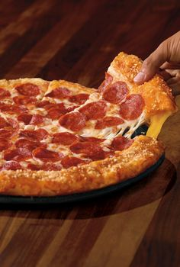

Slide 7
The components of good teaching practices:
Good teaching involves several key components that work together to create an effective learning environment. Some of these components include:
Creating a suitable conducive learning environment for students.
Promoting critical and creative thinking.
Providing appropriate testing and evaluation opportunities to measure students.
Progress and identify their strengths and weaknesses.
Developing communication and social interaction skills .
Providing them with the necessary support and guidance.
Flexibility and Responsiveness: Effective teachers are flexible and responsive to the needs of their students, adapting their teaching methods as needed.
Knowledge of Content: Teachers must have a deep knowledge of the subject they are teaching and be able to communicate this content effectively to their students.

Slide 8
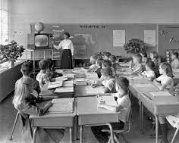
Early developments of Educational Technology

Slide 9
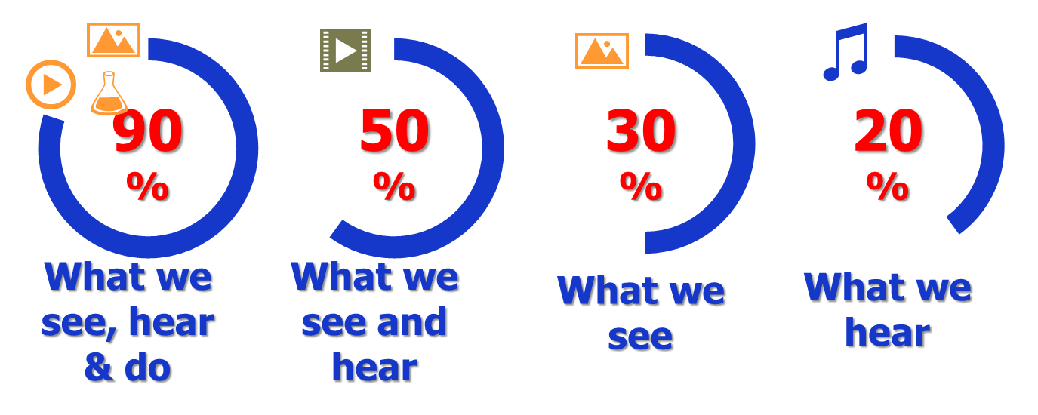
How does learning happen?

Slide 10
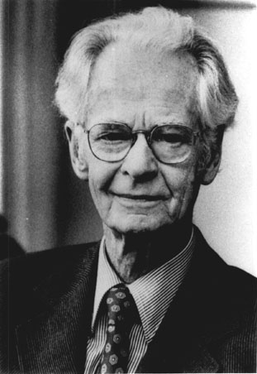
The Programmed Instruction Movement
New Ideas on how humans can learn better, and the characteristics of effective instructional materials.
These characteristics include:
Small sequential steps of instructions
Overt responses for frequent questions
Immediate feedback
Allow self-paced learning
B.F. Skinner 1904-1990

Slide 11
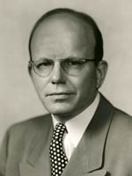
The Behavioral Objectives Movement
It states that designing programmed instructional materials often began by identifying the specific objectives learners who used the materials would be expected to attain.
Tyler Claims, Each Objective must be defined in terms which clarify the kind of Behavior the course should help to.
R. Tyler 1902-1994

Slide 12
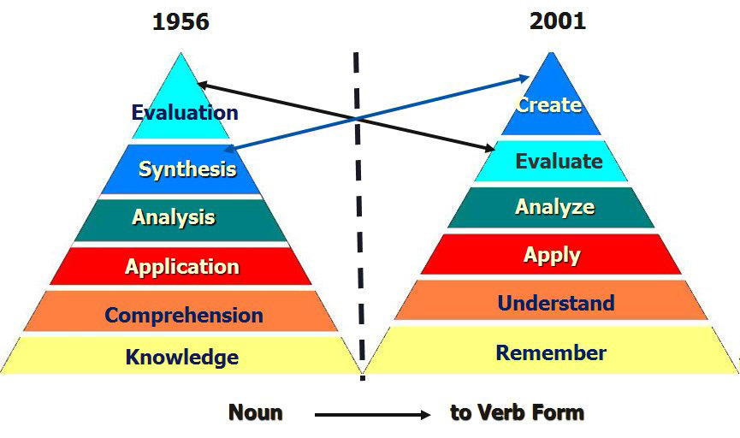
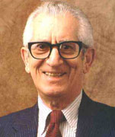
The Behavioral Objectives Movement
B. Bloom 1913-1999

Slide 13
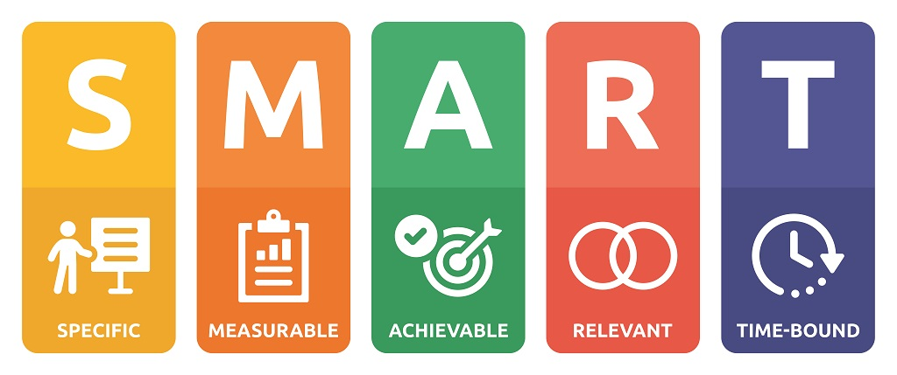
The Behavioral Objectives Movement
R. Mager 1913-1999

Slide 14
Good teaching seeks to equip students with the knowledge and skills they need to become well-rounded individuals who can make positive contributions to society.

Slide 15
Recent trends in e-Learning

Slide 16
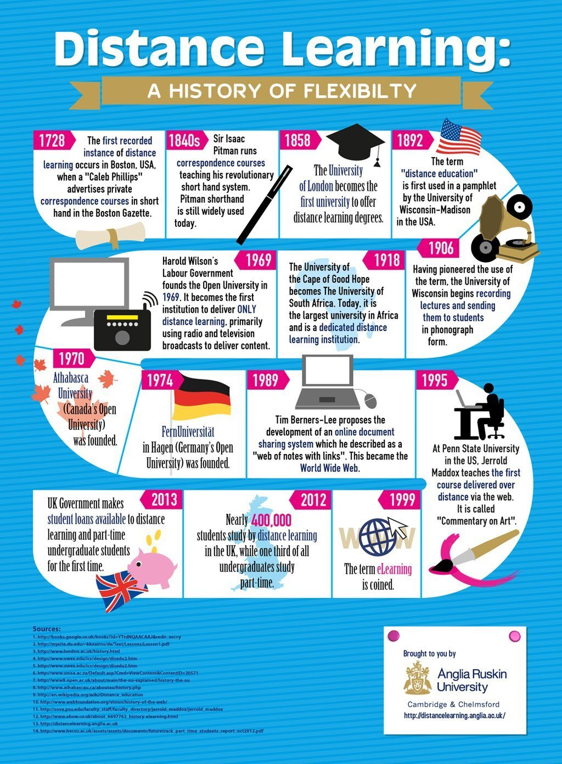

Slide 17
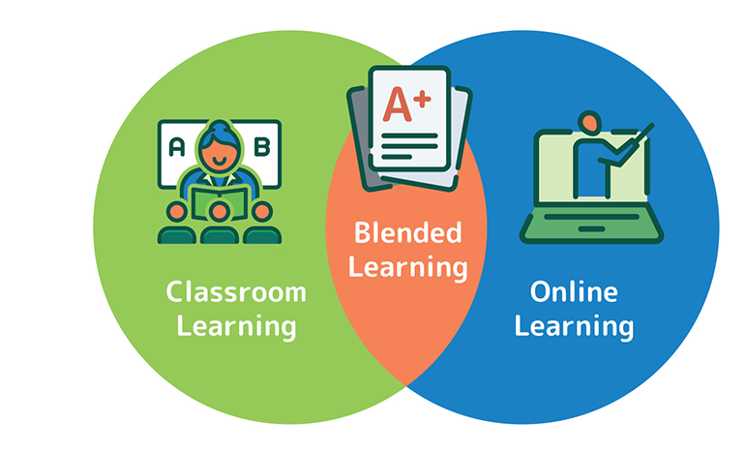
Blended Learning
It is an approach that combines online educational materials with traditional classroom methods.
Employment: you can use many educational strategies in electronic and traditional parts.

Slide 18
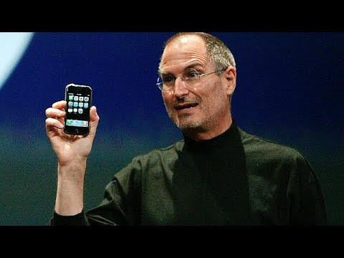
Mobile Learning
It is a new way to access learning content using mobile devices. It allows you to learn whenever and wherever you want, provided that you have a modern mobile device connected to the Internet.
Employment: We can make all our interactive courses to be Mobile Friendly, employing the suitable Learning Strategies.
Steve Jobs Introducing The iPhone At MacWorld 2007

Slide 19
Spaced Learning
It is an approach to instruction and review of learned content that alternates short, intensely focused periods of learning with breaks, repeated over increasingly long periods of time.
Employment: We can use E-Learning in learning periods or breaks.

Slide 20
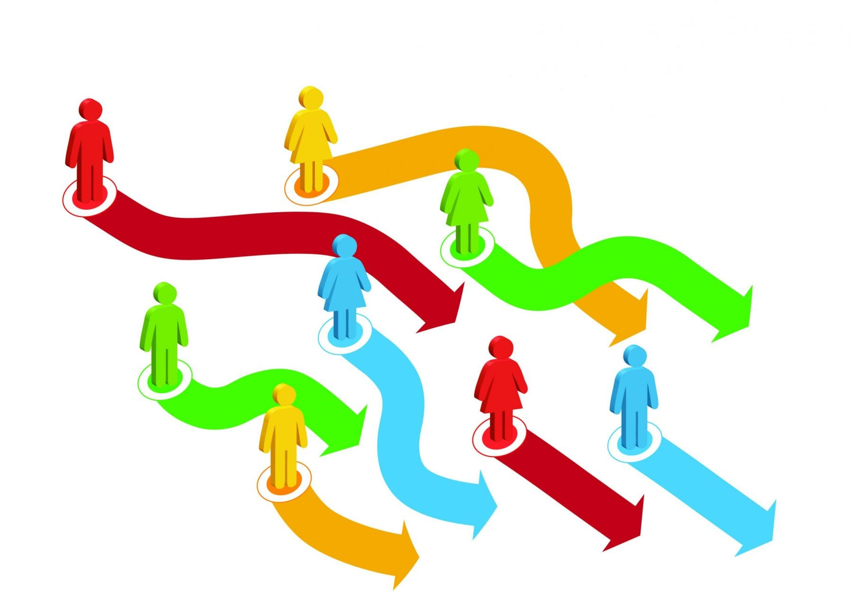
Adaptive Learning
It is a technology that provides learning activities to students, based on their needs and learning style/behavior. Consider adaptive learning as a piece of tech which adapts to every students’ needs in a short time.
Employment: you can use many educational strategies to helps students to adapt to unique learning paths that are entirely based on their interests and learning ability.

Slide 22
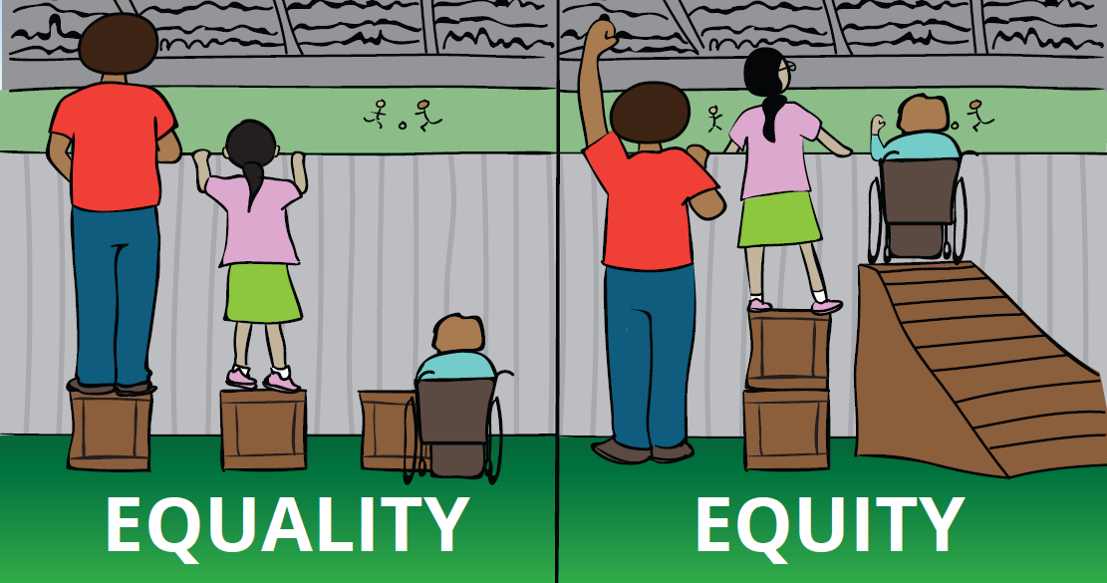

Slide 23
Virtual Learning Environments (VLE)
A web-based platform that presents resources, activities, and interactions within a course structure and provides assessments and reporting of participations.
Employment : LMS can provide VLE with multi-resources.

Slide 24
Virtual Classroom
It is an online learning tool that allows for live interactions between tutors and learners as they participate in learning activities.
Nowadays VC can work as an Integrated platform.
Employment: VC can be used for life sessions also can be used as a repository and platform, Ex. MS Teams

Slide 25
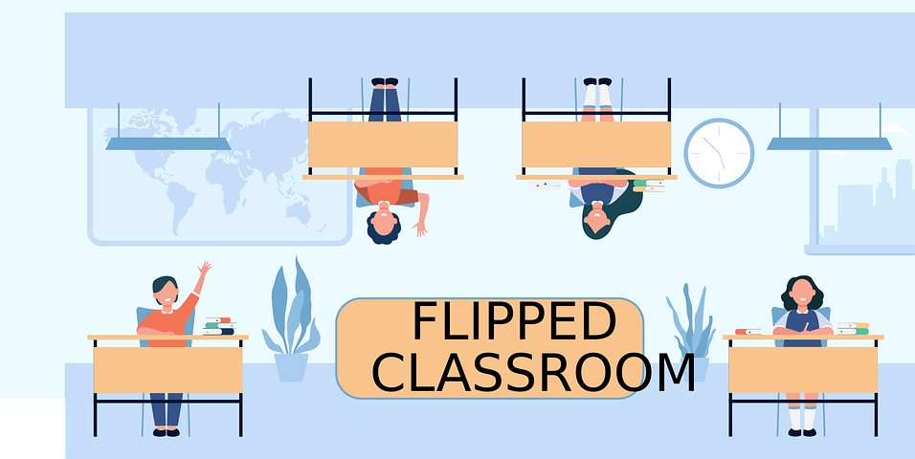
Flipped Classroom
It is a type of Blended Learning, which aims at increasing Learners’ engagement and learning by having learners' complete readings at home and work on live problem-solving and activities during class time
Employment: you can use many educational strategies in electronic and traditional parts.

Slide 26
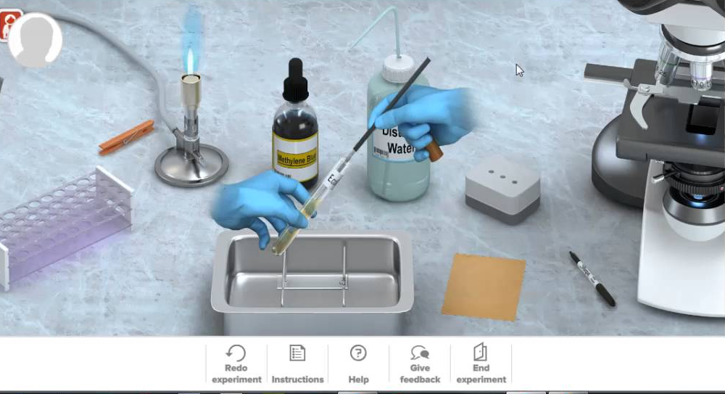
Virtual Laps
It can be used to enhance learning in subjects such as physics, mathematics, and engineering. Students can use simulation technology to design and test virtual race cars or other vehicles and analyze the data to understand the principles of mechanics and aerodynamics.
Employment: Virtual laps offer a fun and engaging way to learn and apply concepts in various academic disciplines.

Slide 27
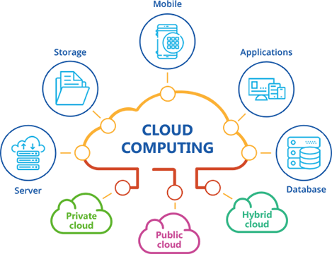
Cloud Computing
It is an on-demand availability of computer system resources, especially cloud data storage, without direct active management by the user.
Employment: Data centers in Universities managed by systems as UMS.

Slide 28
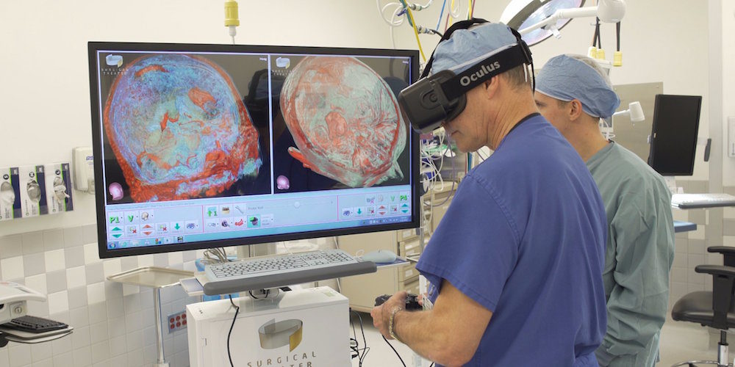
Simulation & Virtual reality
It is a simulated experience that can simulate real world problems and systems.
Employment: It can be used to simulate dangerous experiments and abstract information.

Slide 29
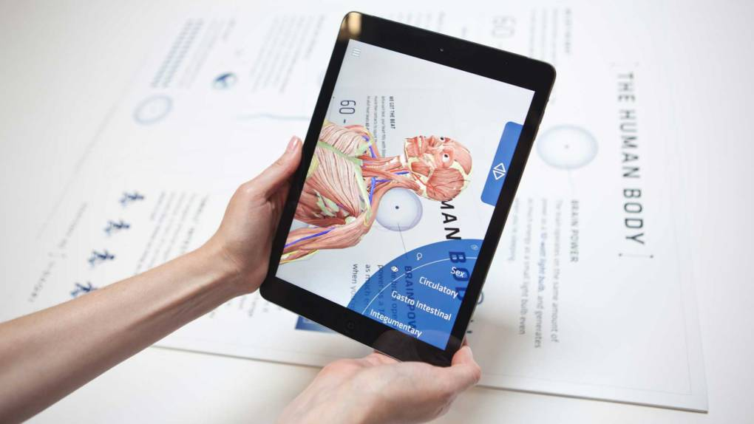
Augmented Reality
It is an interactive experience of a real-world environment where the objects that reside in the real world are enhanced by computer-generated perceptual information, sometimes across multiple sensory modalities, including visual, … etc.
Employment: We can use software to visualize learning using smart devices .

Slide 30
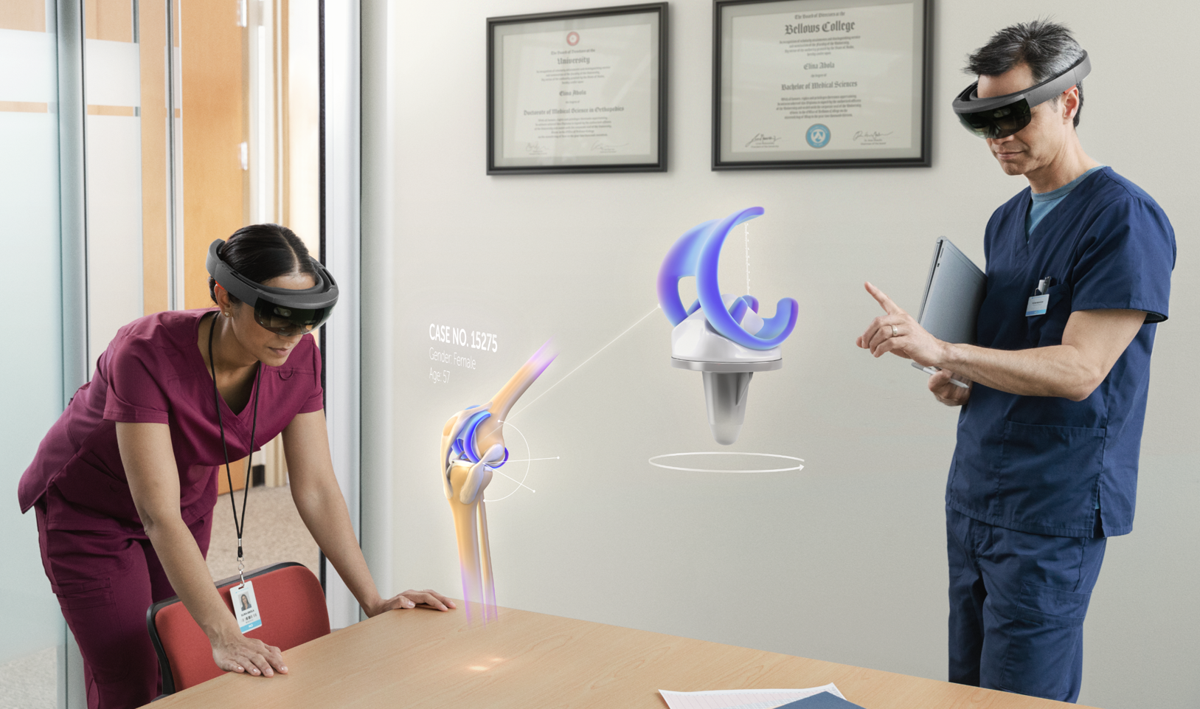
Hologram
It is a three-dimensional image created by the interference of light beams from a laser or other coherent light source. It appears to be a solid object but is actually a projection of light that gives the illusion of depth and dimensionality.
Employment: It can be used to bring complex concepts to life, allowing students to visualize and interact with abstract concepts in a way that is not possible with traditional teaching methods.

Slide 31
Gamification
It is a set of competitive activities and processes to solve problems by applying the characteristics of game elements and Mechanics. Its elements are Points, Badges, Leaderboards, Performance graphs, … etc.
Employment: It can be used to create an atmosphere of competition between students based on motivation.

Slide 32
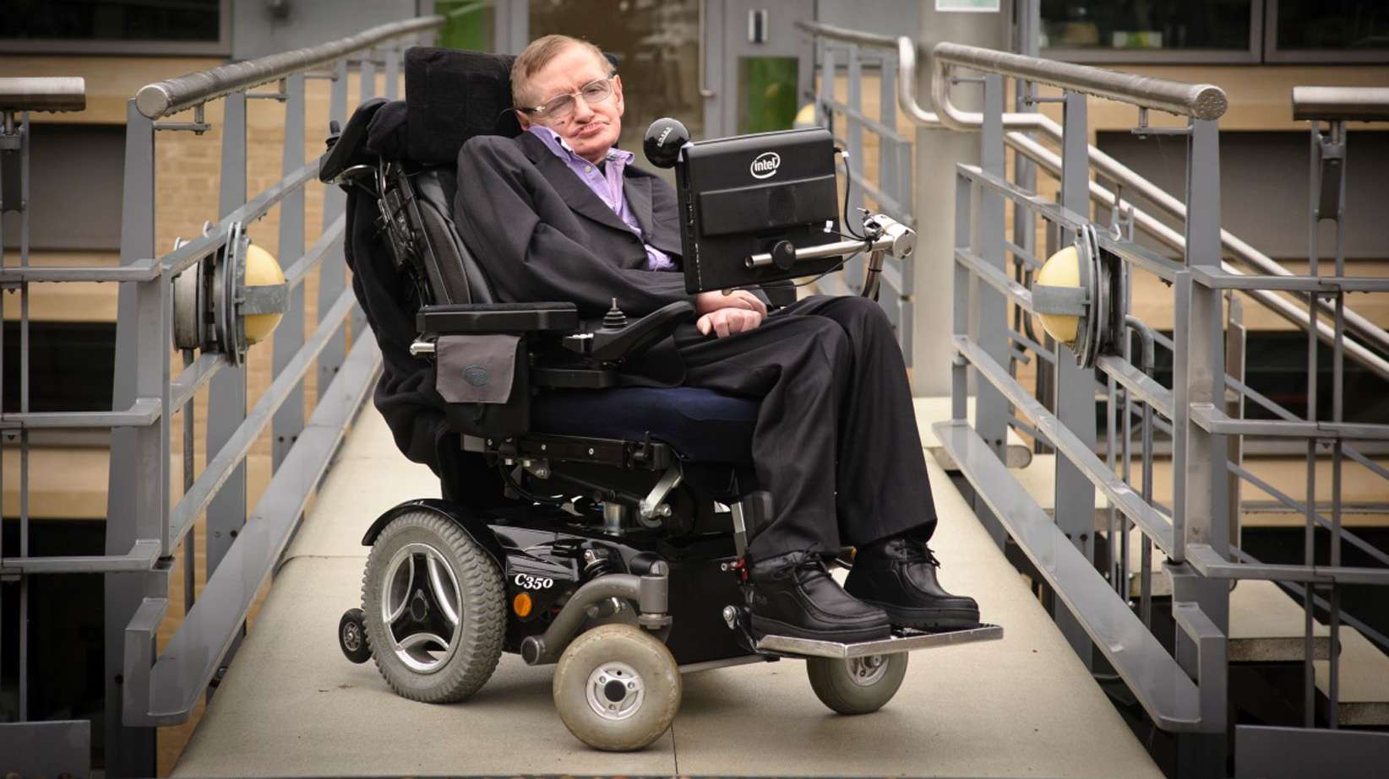
Internet of Things IoT
It is a network of devices that are connected to the internet and can communicate with each other. The IoT has the potential to transform education by providing new ways for students to learn and teachers to teach.
Employment: It can be used in: Smart classrooms, Personalized learning, Remote learning, Safety and security.
Stephen Hawking

Slide 33
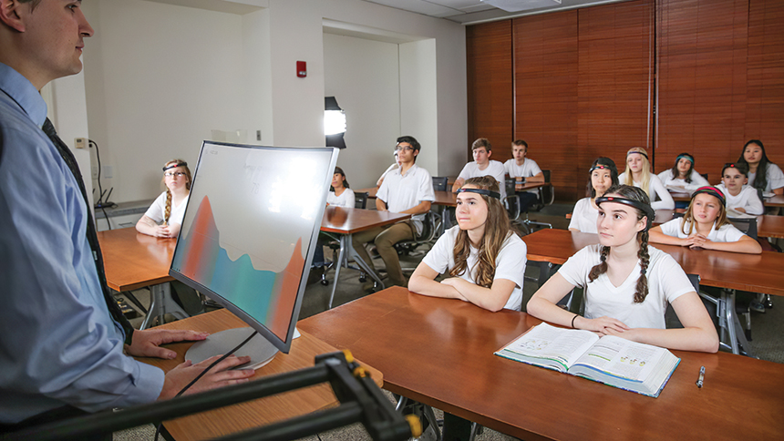
Internet of Behavior IoB
It is a concept that involves the use of data from various sources, such as sensors and wearable devices, to understand and influence human behavior. In education, IoB can be used to track student behavior and provide personalized recommendations based on their habits and preferences.
Employment: It can be used to track a student's study habits and suggest resources or study materials that align with their learning style. It can also monitor attendance and engagement in class and provide feedback to teachers on how to improve student engagement.

Slide 34
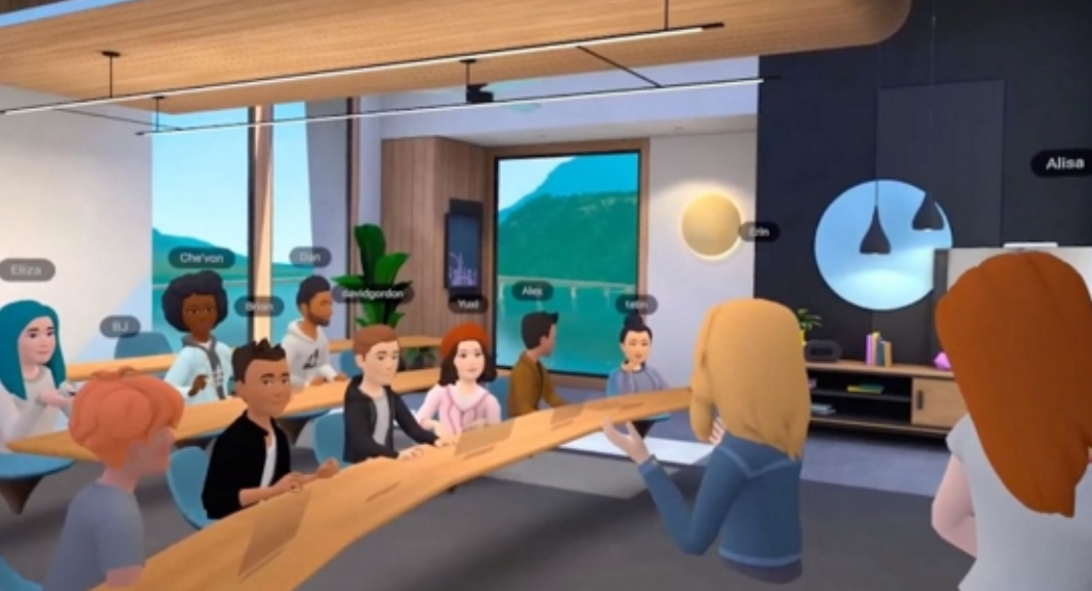
Metaverse
It is a virtual reality platform that allows users to create and share their own interactive 3D experiences.
Employment: Schools can identify the areas where Metaverse can be used to improve learning outcomes and student engagement. This could include virtual field trips, interactive lessons, or collaborative projects.

Slide 35
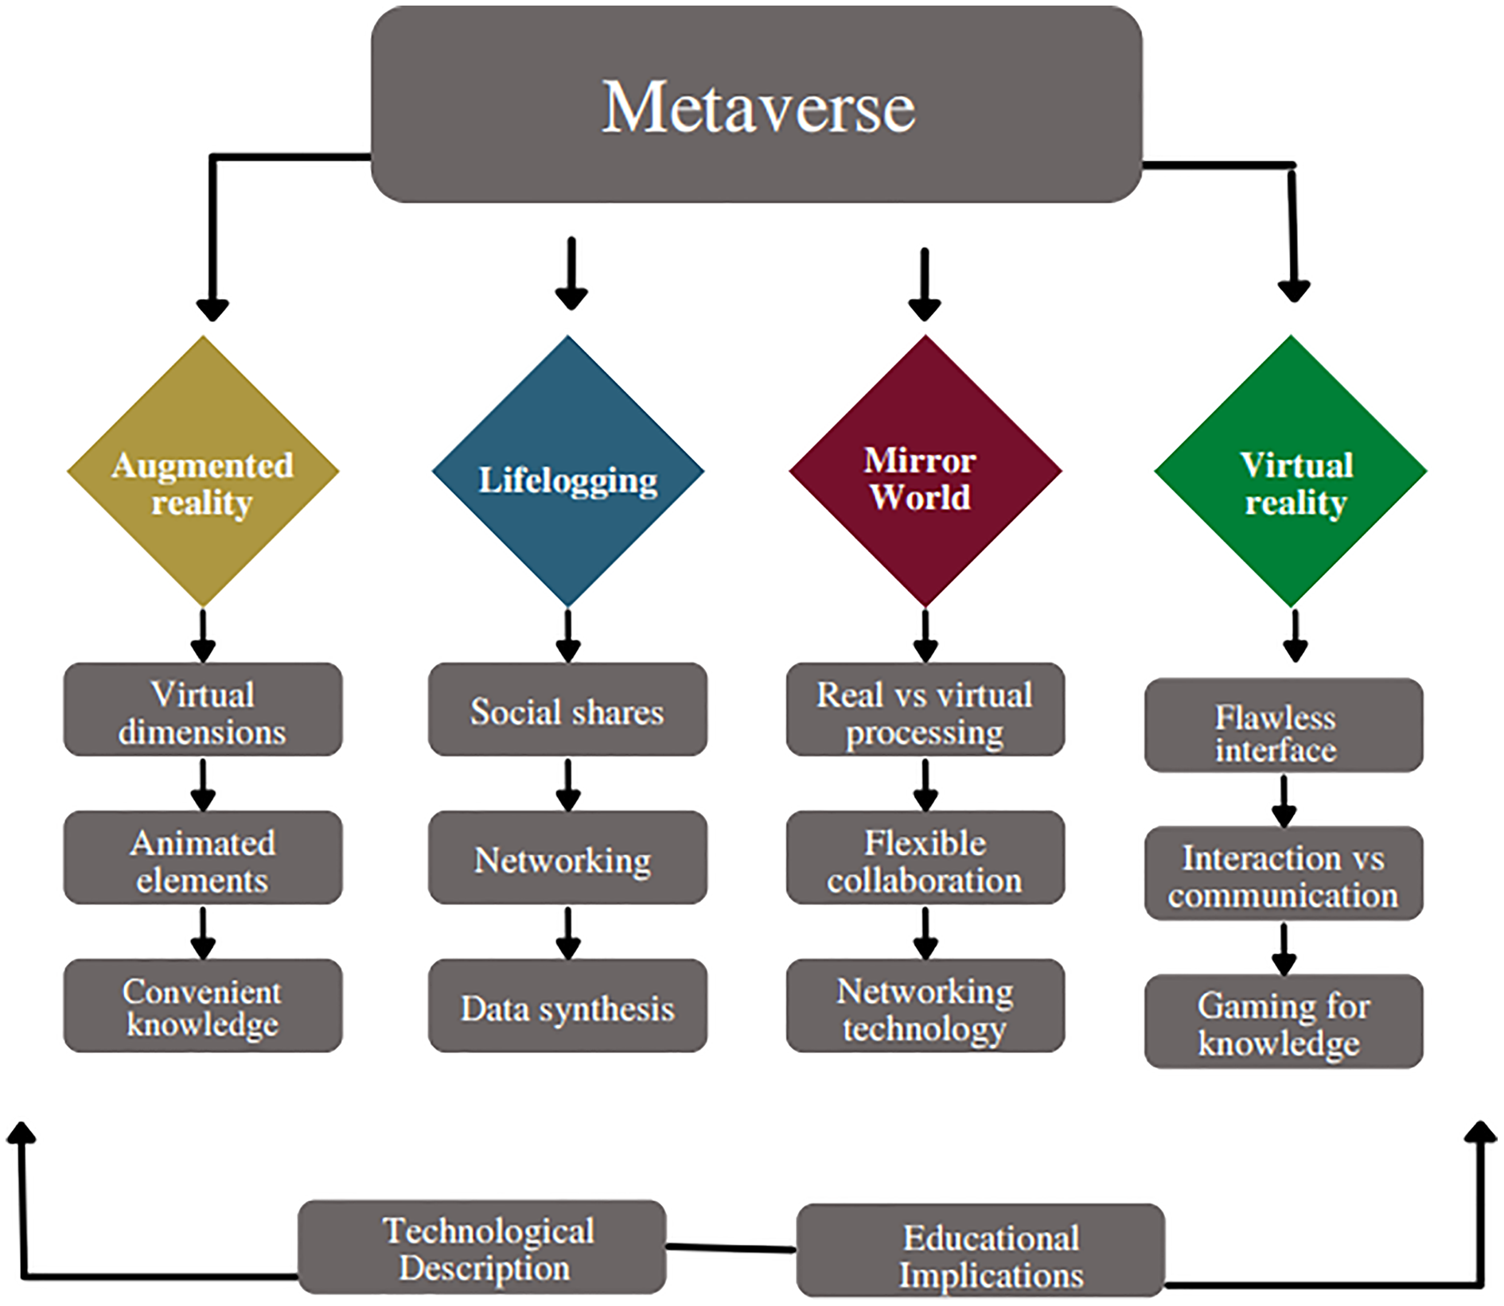

Slide 36
Artificial Intelligence (AI)
It is very well regarded as one of the most discussed technology trends in the world. Due to its smart approach towards various systems, the world has come to trust its technology in its development.
Employment: Its existence has helped the world evolve, and luckily by 2023, education is set to experience more levels of evolution from it.

Slide 37
ChatGPT
Recently developed by OpenAI, ChatGPT is a state-of-the-art chatbot that has been trained in multiple languages using advanced deep learning techniques. Its sophisticated technology enables it to comprehensively understand text and effectively respond to a wide range of inquiries. The software has numerous potential applications across a variety of industries.
Including: Learning and Teaching, Consulting and Technical Support, Translation, Time Planning and Task Management, Marketing and Advertising,

Slide 38
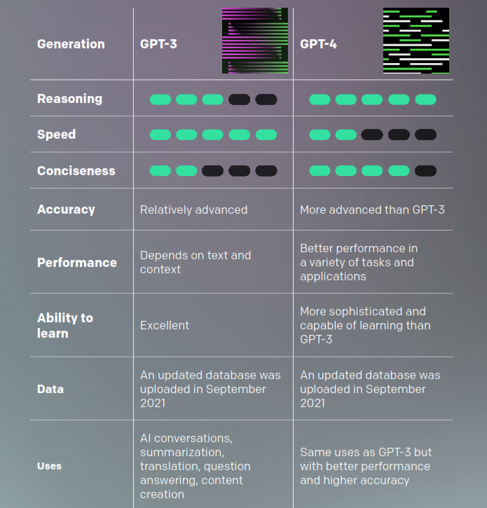
GPT-3
Vs
GPT-4
30/11/2022
14/3/2023
Generative Pre- trained Transformer
المحول التوليدي المدرب مسبقا

Slide 39
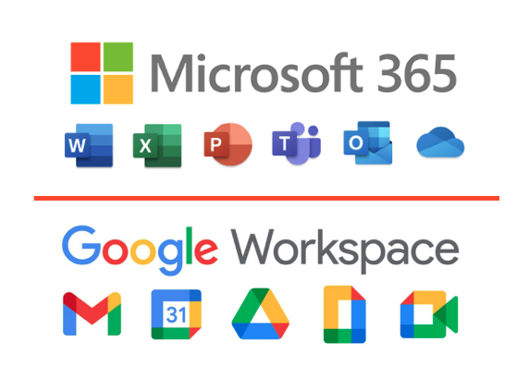
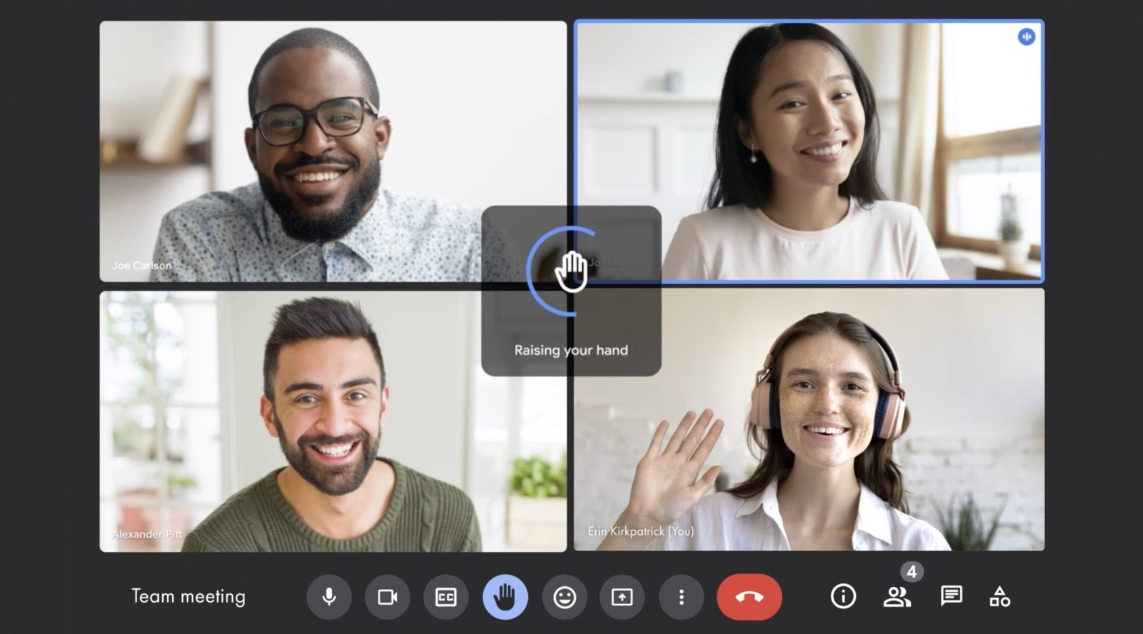
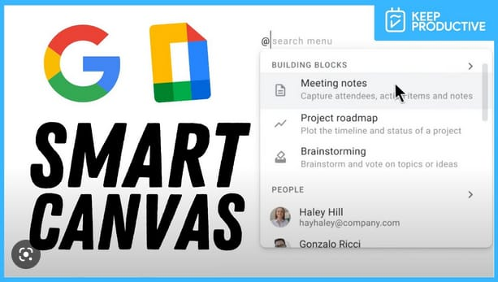
AI recent revolution

Slide 40
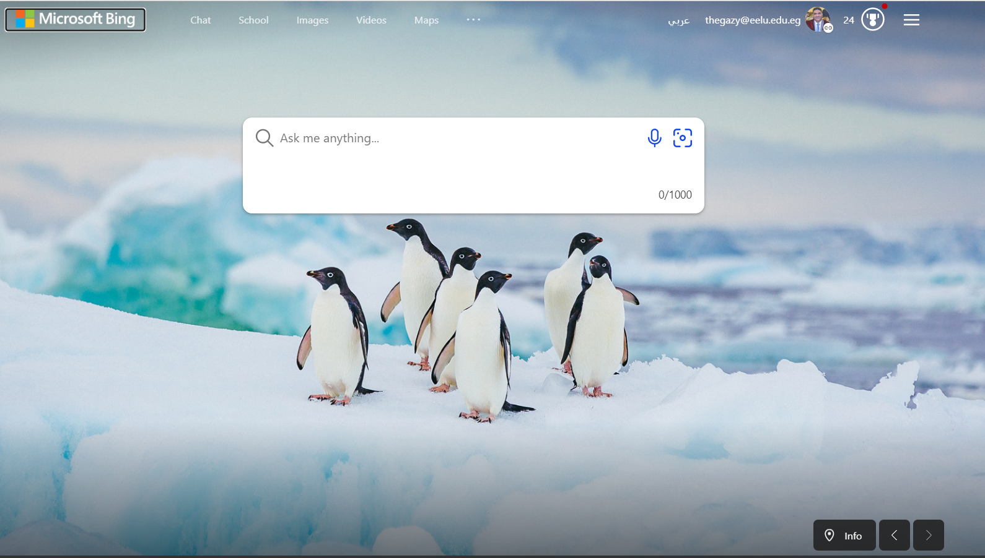
For Researchers
Microsoft Bing

Slide 41
AI Tools

Slide 42
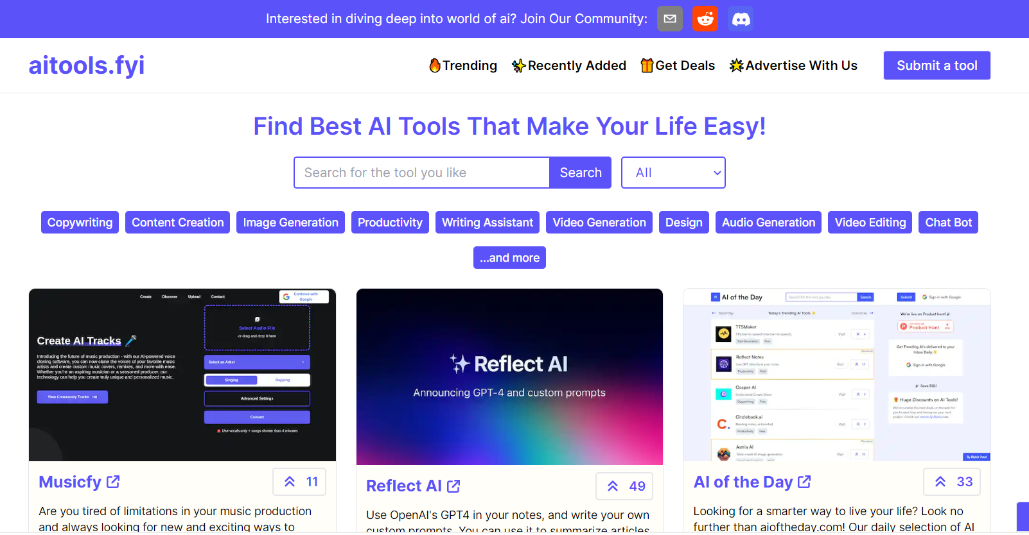
Search Engine
AI Tools

Slide 43
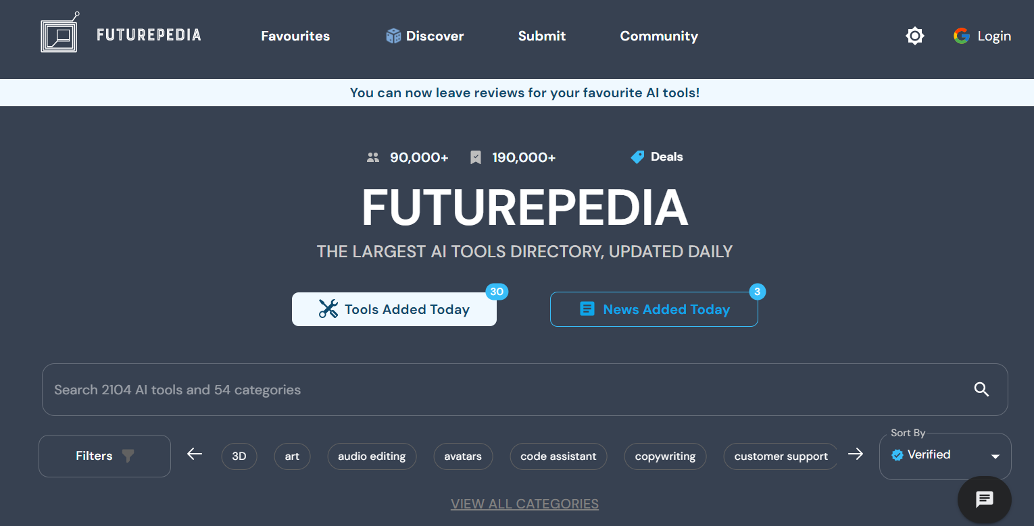
Search Engine
Futurepedia
AI TOOLS
UPDATED DAILY

Slide 44
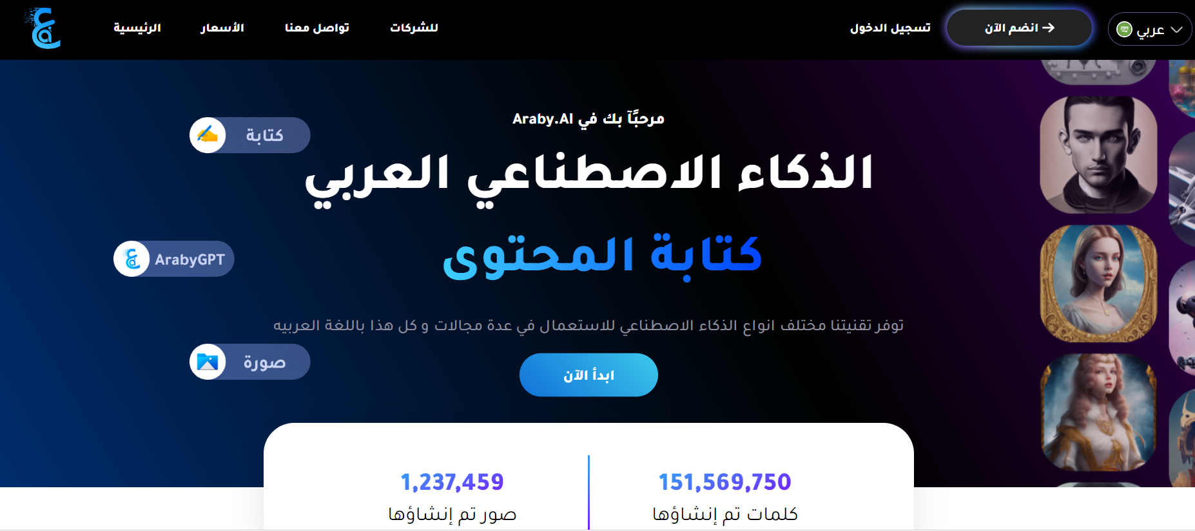
Araby.ai

Slide 45
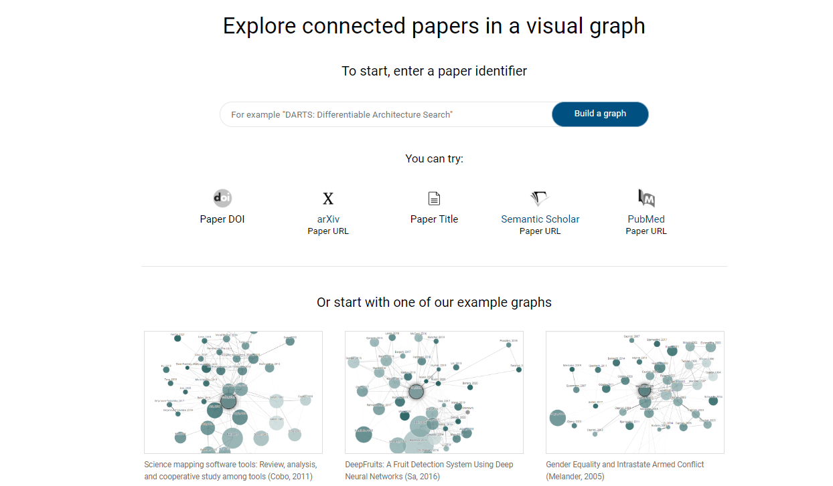
For Researchers
connected papers

Slide 46
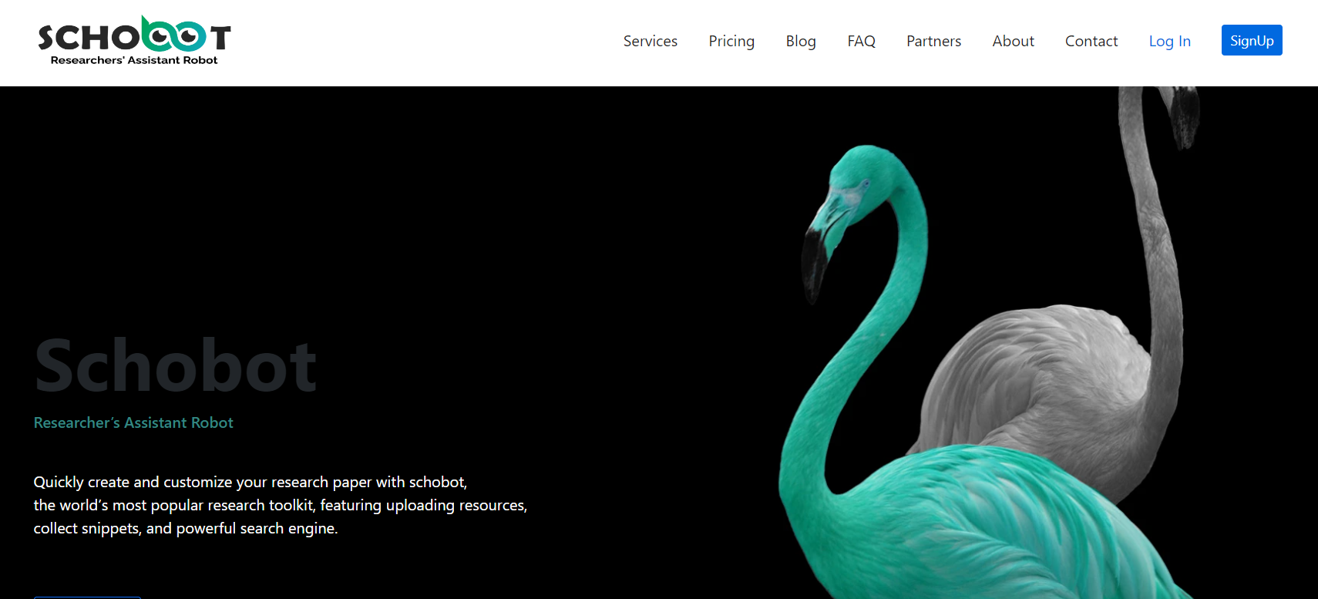
For Researchers
Schobot

Slide 47
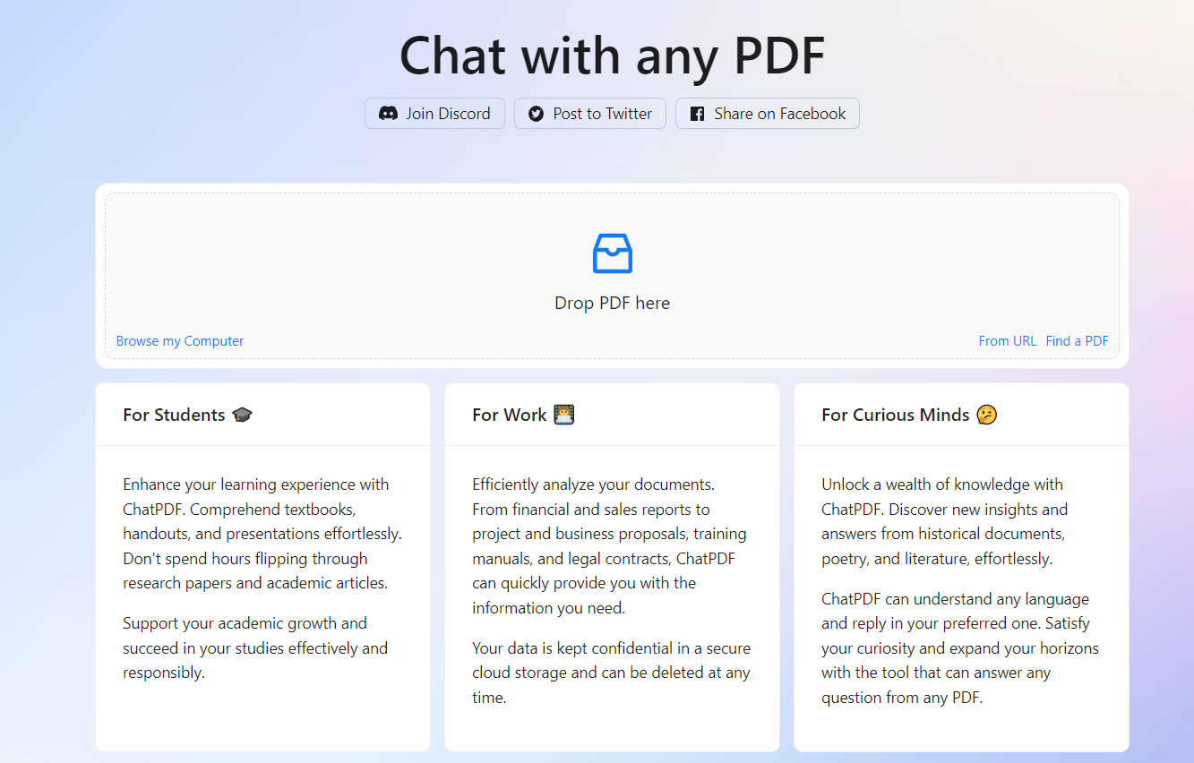
For Researchers
Chat with any PDF

Slide 48
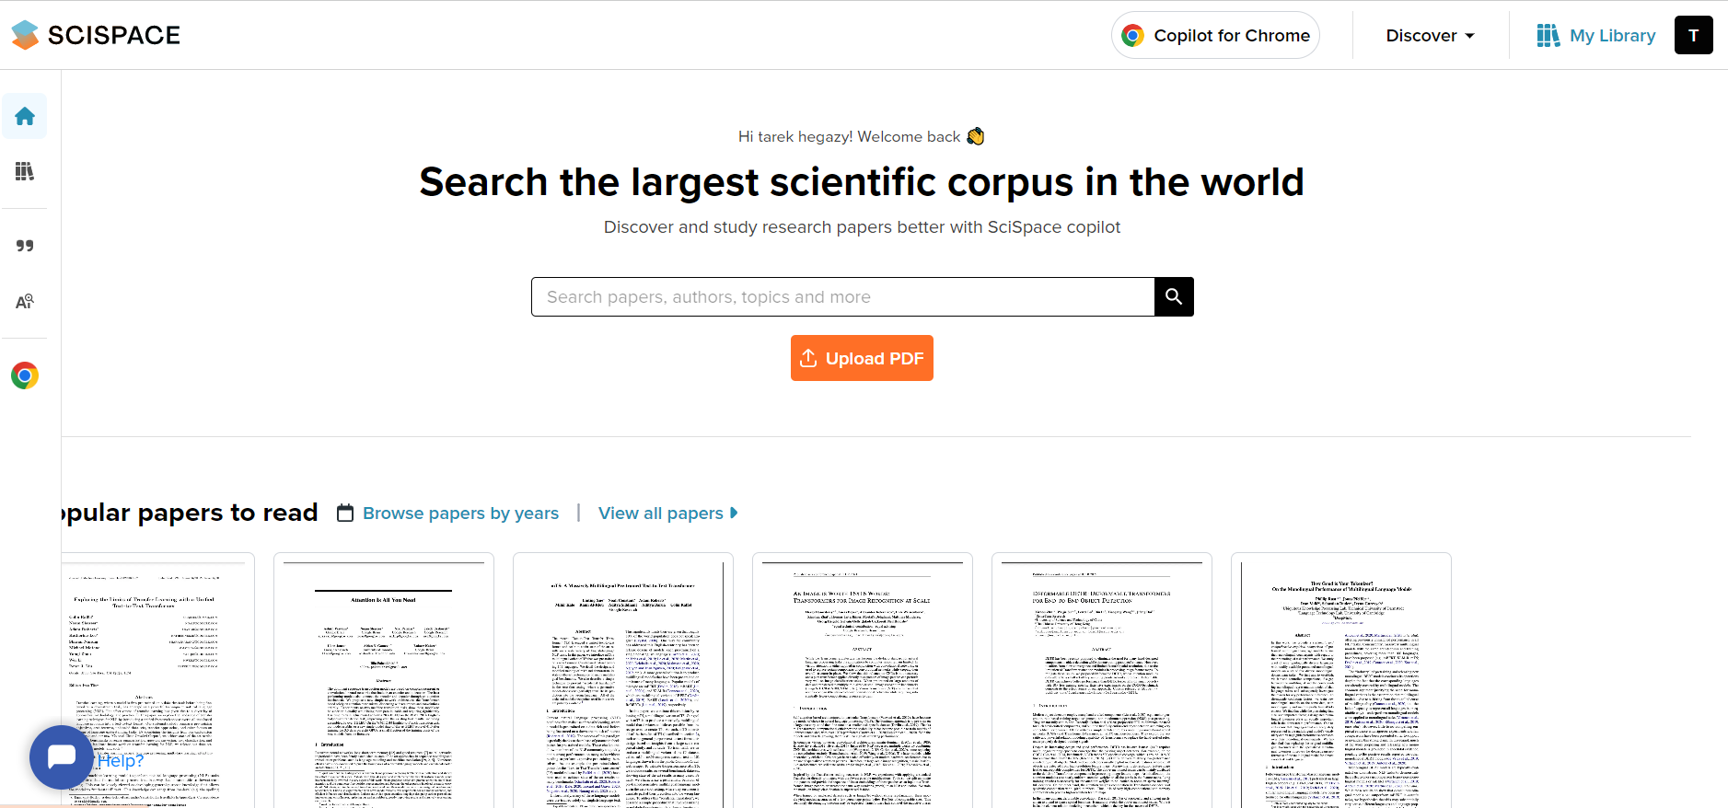
For Researchers
typeset.io
SciSpace copilot

Slide 49
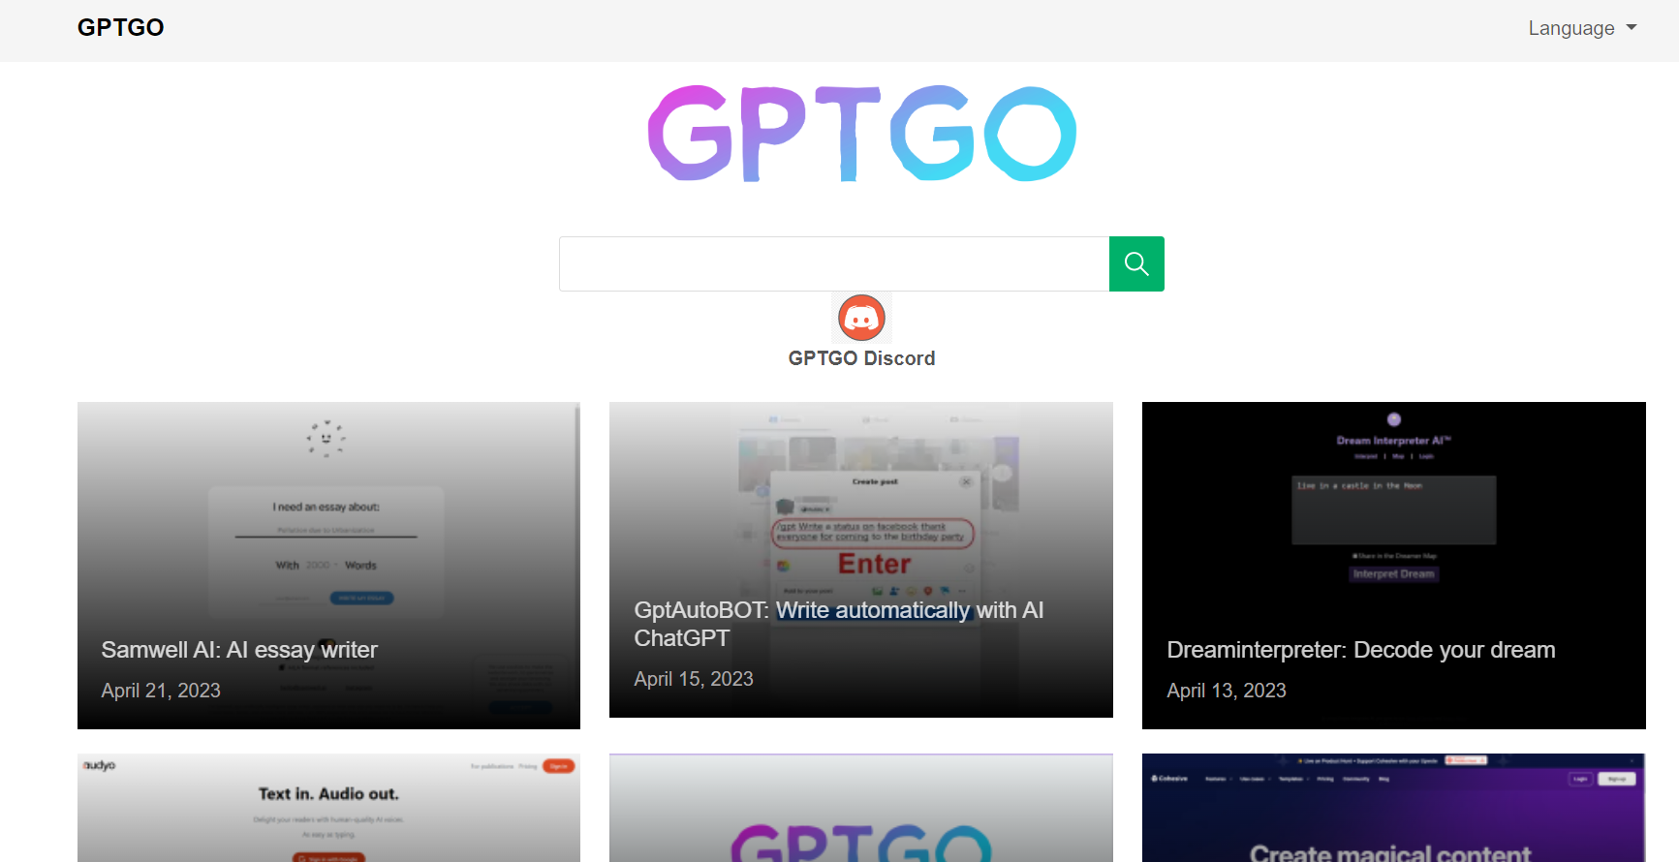
For Researchers
GPTGO.AI

Slide 50
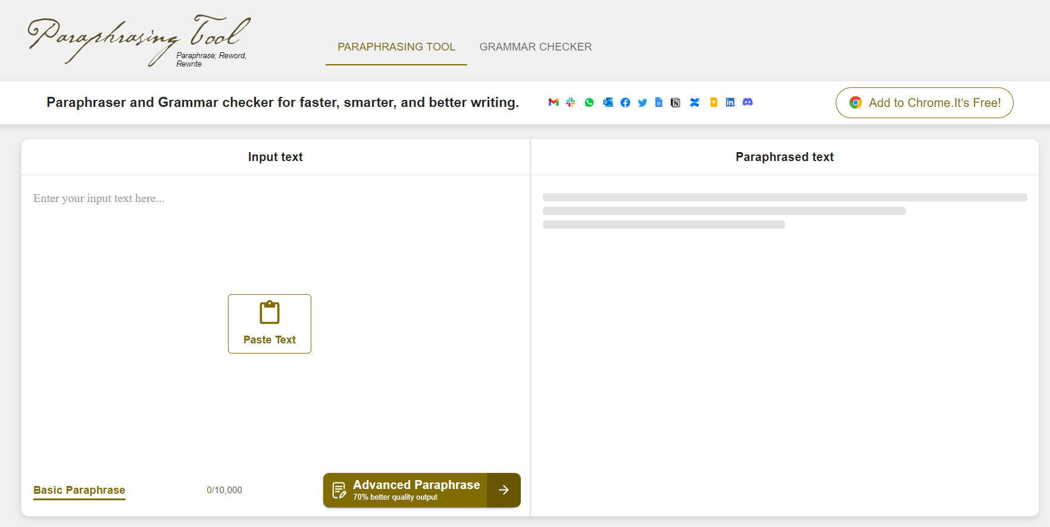
For Researchers
Paraphrasing-tool

Slide 51
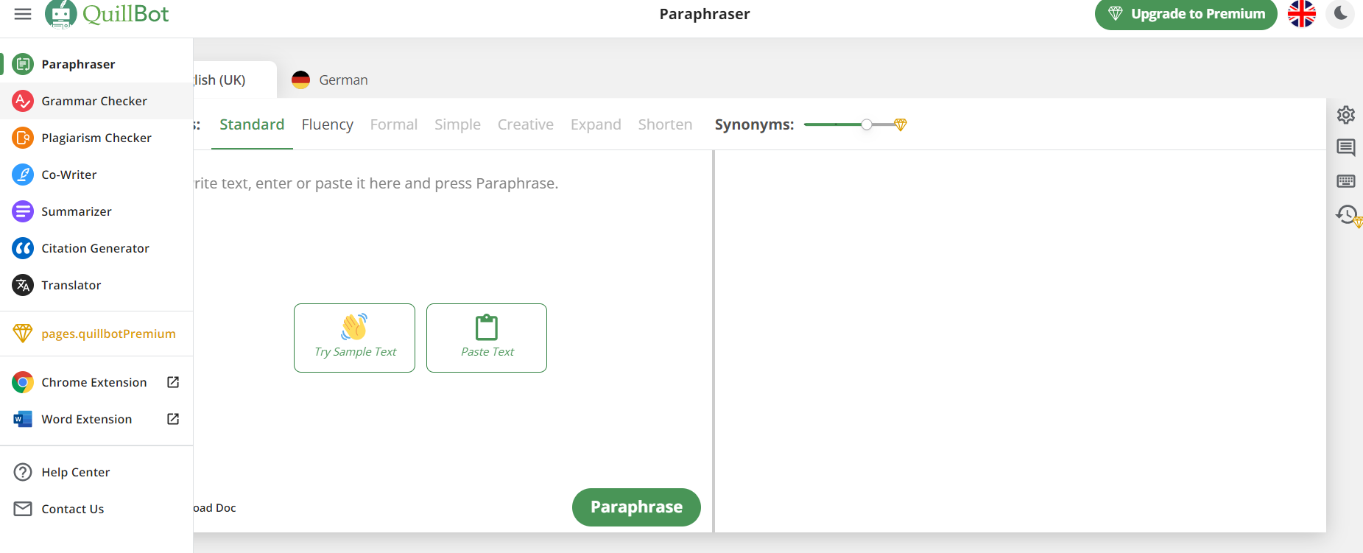
For Researchers
Quill Bot

Slide 55
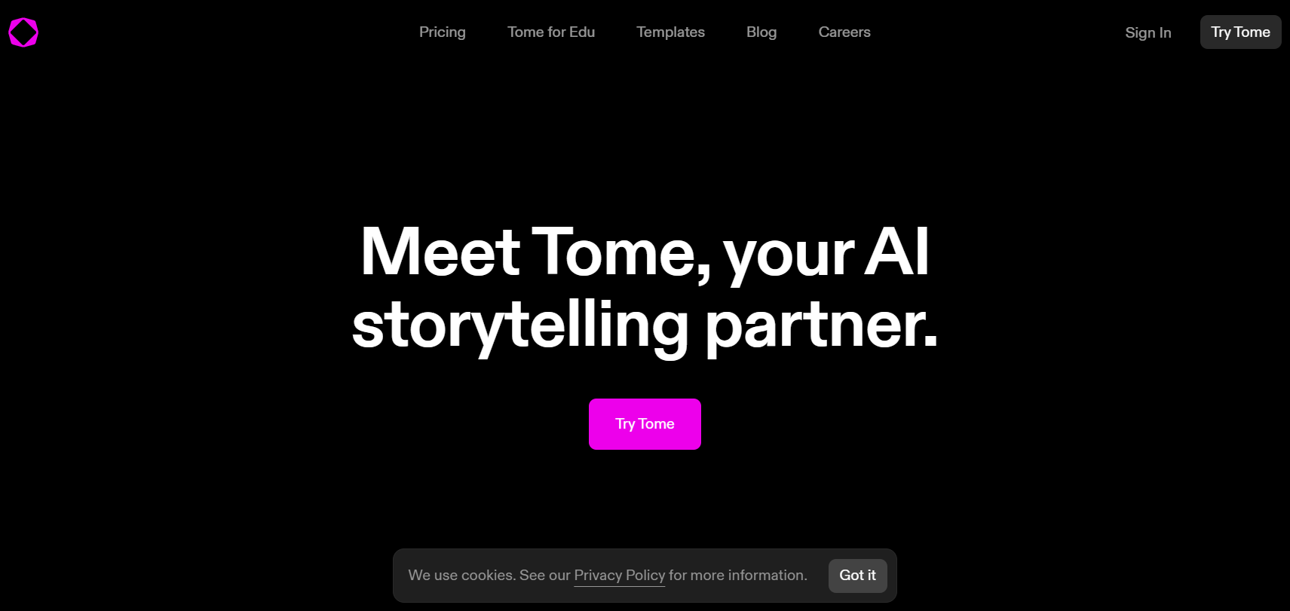
For Teachers
Tome storytelling

Slide 56
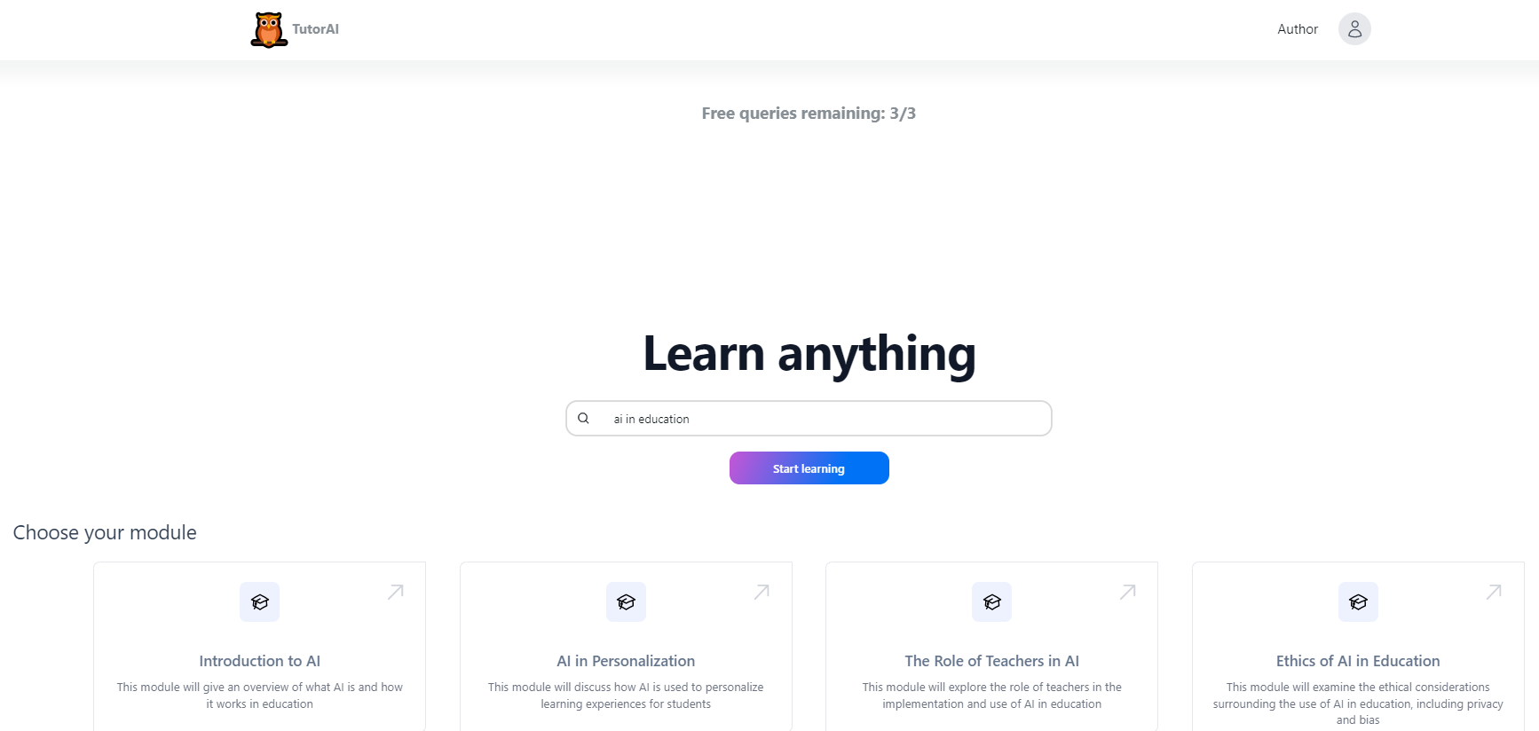
For Teachers
tutorai

Slide 57
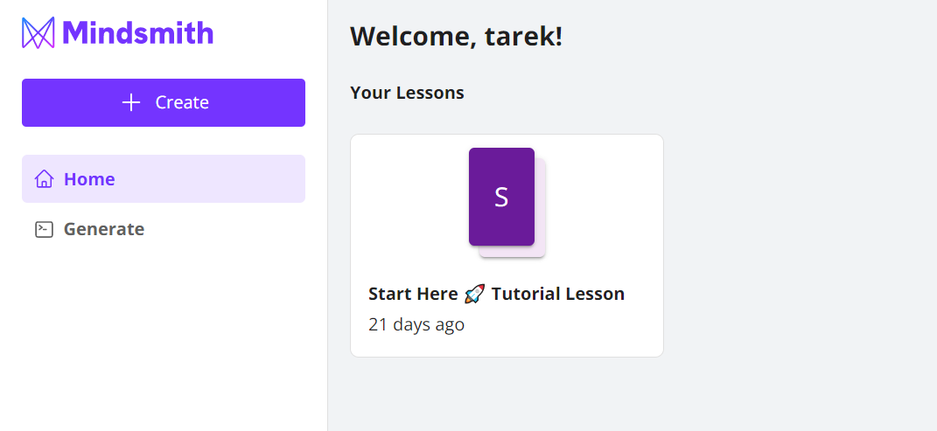
For Teachers
Mindsmith for create your lesson

Slide 58
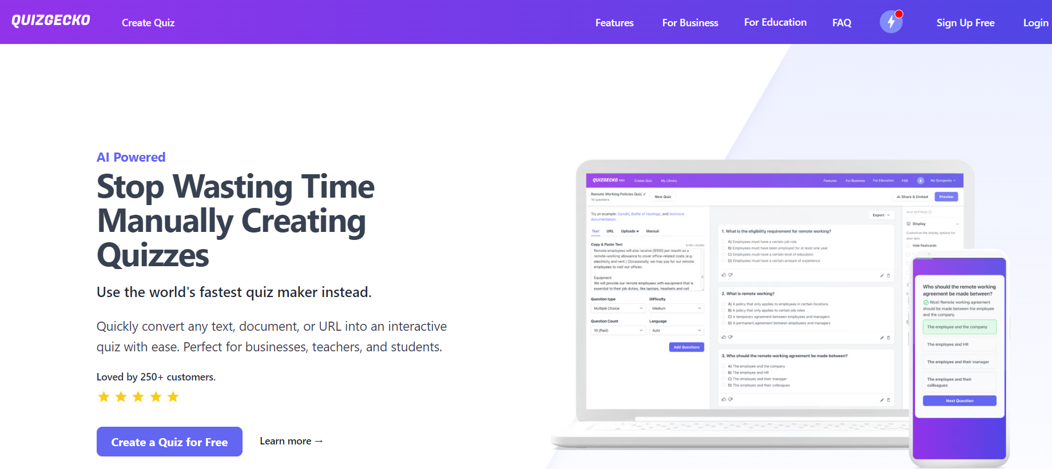
For Teachers
Quiz Gecko

Slide 59
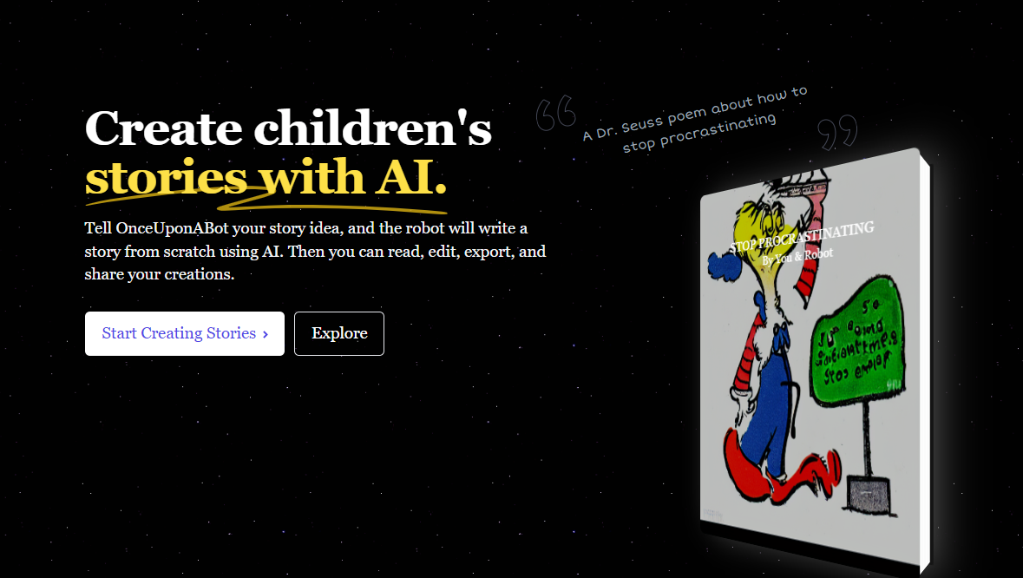
For Teachers
Create children's stories

Slide 60
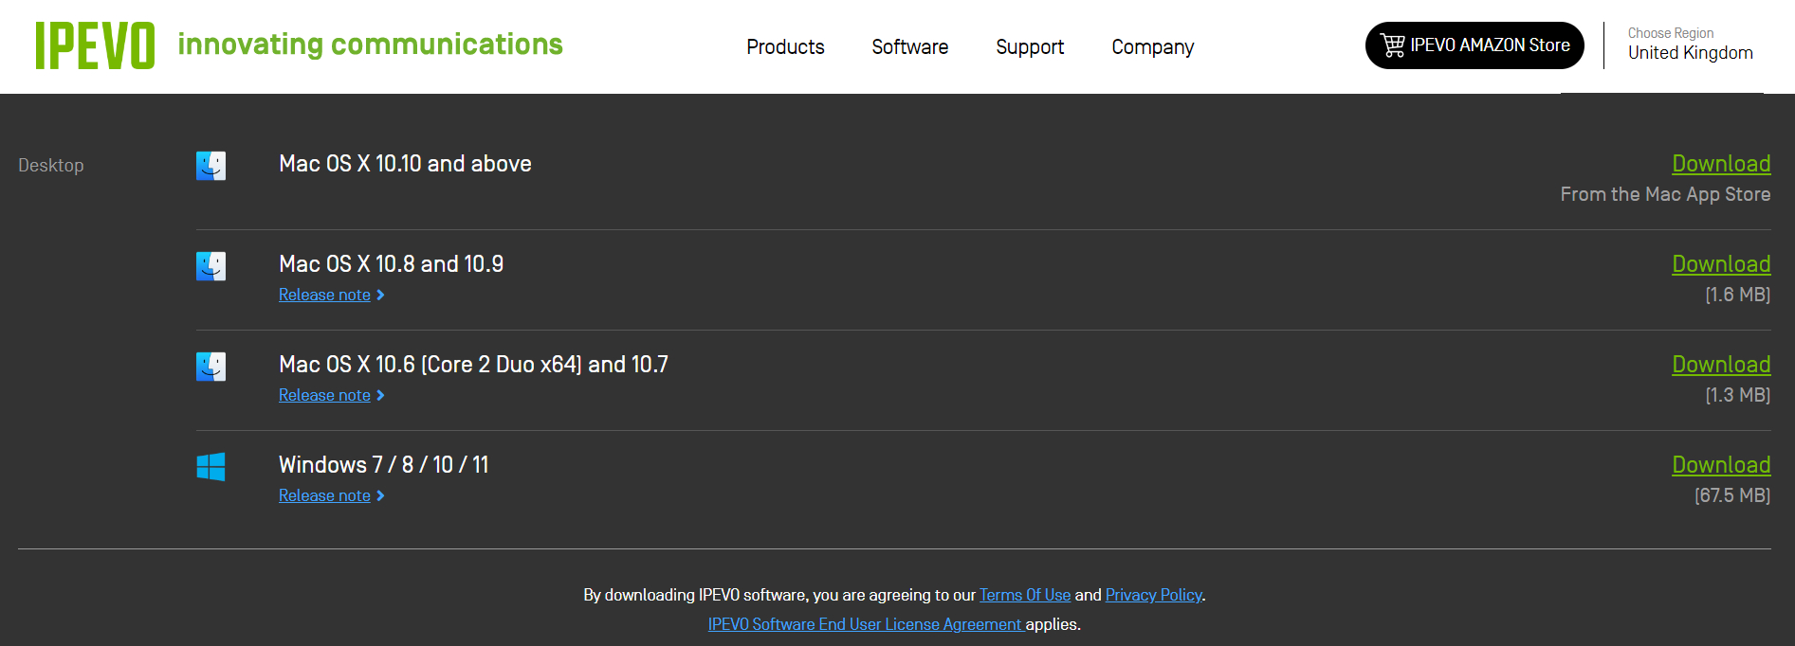
For Teachers
Interactive Whiteboard Systems

Slide 61
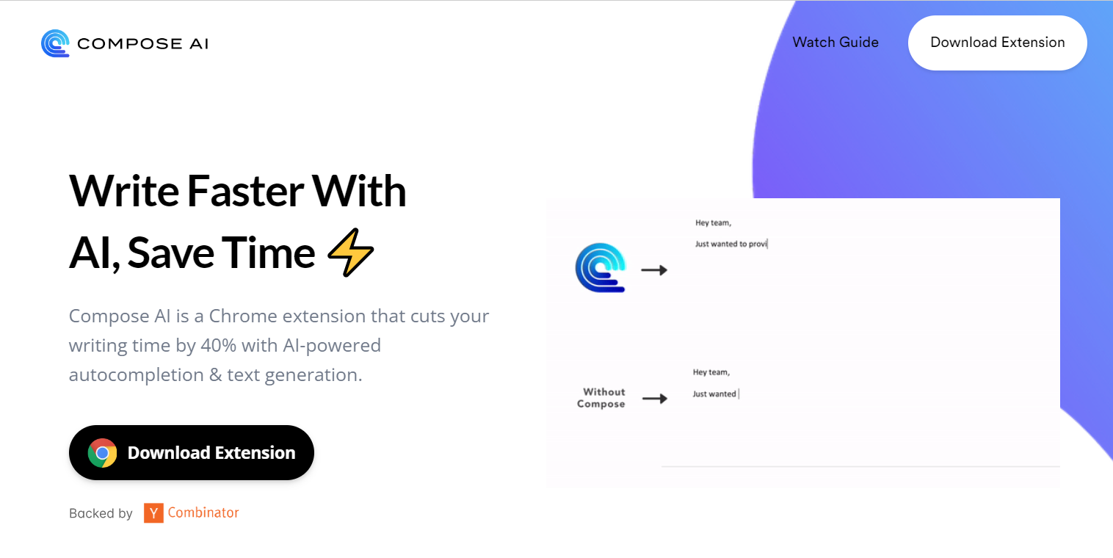
AI Tools
Compose AI is a Chrome extension

Slide 62
AI Tools
Remove Image Background

Slide 63
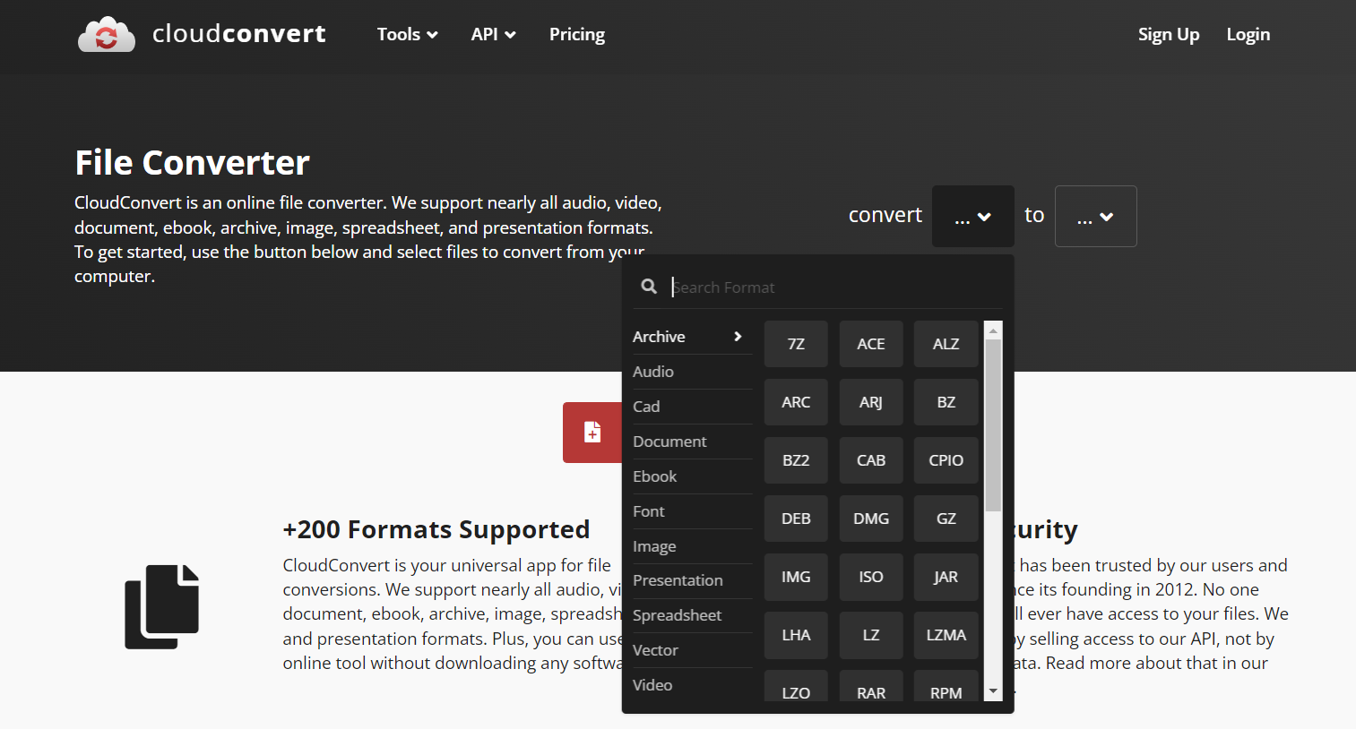
AI Tools
Cloud Convert

Slide 64
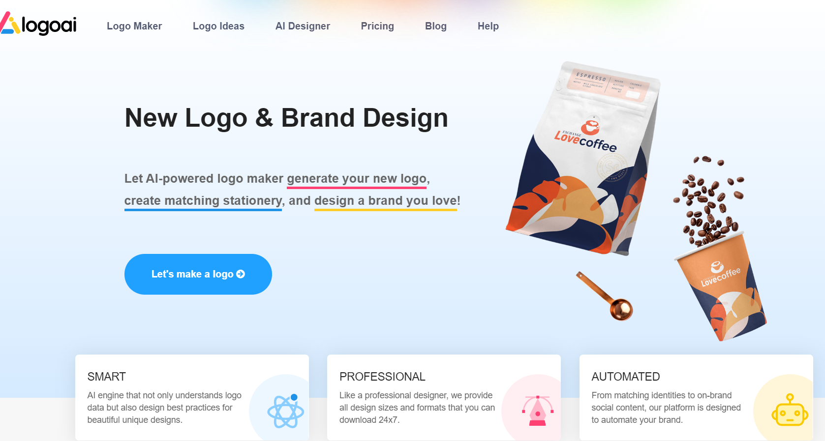
AI Tools
Logo & Brand Design

Slide 65
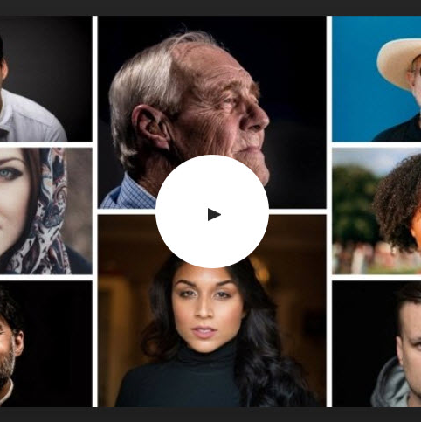
Recommended App Lists
remove
ilovepdf
clipchamp
magiceraser.io
ttsmp3.net
dictation

Slide 66
Recommended App Lists
pixlr
flickr
pixabay
Unsplash

Slide 67
Recommended App Lists
Quizizz
canva
jamboard
Kahoot
classroom.google
nearpod

Slide 69
Address
37,New city , General road
Thank You ..
www.eelu.edu.eg
+201028852808
Dr. TAREK HEGAZY
thegazy@eelu.edu.eg

